Slide 1
Designing the Experiment: Research Goals and Hypothesis
Week 4

Slide 2
Recap
In Week 3
  Types of usability testing research
  Data
  Data and methods to collect the correct data
This week we will look more extend
  Forming a Research question and developing research hypotheses
  Variables in the context of usability testing
  Experimental research & experimental design

Slide 3

Usability testing goals
“UX research should always be done for a clear purpose – otherwise you’re wasting the both your time and the time of your participants. But many people who do UX research fail to properly articulate the purpose in their research objectives. A major issue is that the research objectives include assumptions that have not been properly defined.”
Posted on September 21, 2019 in User Experience

Slide 4
Usability testing goals
Before you start planning for usability testing you need to define the objectives/goal of the usability testing study, in other words what you want to achieve, and why
A clear objective/goal:
  makes is easier to create a proper list of usability testing questions (the research questions)
  create hypothesis
  those will determine the test material to be created
  test plan

Slide 5
Types of behavioural research
Behavioural research questions focus on understanding and explaining human behaviour.
In the context of UX and usability we are interested in user behaviour

Slide 6
Common types of behavioural RQ
Descriptive investigation/research
Relational investigation/research
Experimental investigations (causal research)
?

Slide 7
Descriptive investigation
Focuses on constructing an accurate description of what is happening
RQ: “How does the user experience in playing games impact their touch-typing proficiency?”
A researcher sets up a task asking 22 teenagers to type some text using a mobile device that supports touch type.
The researcher collects information about the users’ background experience
The researcher observes that 8 out of 10 teenagers in a class who frequently play a specific computer game can touch type while only 2 out of 12 teenagers in the same class who do not play the game can touch type.
This raises an interesting observation, but:
  it does not allow the establishment of a relationship between the two factors: playing the game and typing.
  it does not enable the researcher to explain why this happens.

Slide 8
Relational investigation
Enables identifying relations between multiple factors
That is, the value of factor X changes as the value of factor Y changes.
RQ: “What is the correlation between the user experience in playing games and touch-typing proficiency?”
A researcher may collect data on the number of hours that the teenagers play the computer game per week and measure their typing speed.
The researcher can run a correlation analysis (a statistical test designed to identify relationships between two or more factors) between the number of hours and typing speed.
If the result is significant, it suggests that there is a relationship between typing speed and the time spent playing the game.
The results of relational studies usually carry more weight than what can be learned through descriptive studies.
However, relational studies can rarely determine the causal relationship between multiple factors

Slide 9
Experimental investigation (causal)
Investigates the causal effect between two factors
RQ: How does manipulating the user experience in playing games impact touch-typing proficiency?
The researchers recruits teenagers in the same age group and randomly assigns the teenagers to two groups:
  group A will spend a certain amount of time playing the computer game every week
  group B will not
After a period of time (e.g., 3 months or longer), the researchers can measure each teenager's typing speed.
If the teenagers who play the computer game type significantly faster than the teenagers who do not play the game, the researchers can confidently draw the conclusion that playing this computer game improves the typing skills of teenagers.
Experimental research enables the identification of causal relationships.
The ability of experimental research to identify the true cause of a phenomenon allows researchers to manipulate the way we do research and achieve the desired results.

Slide 10
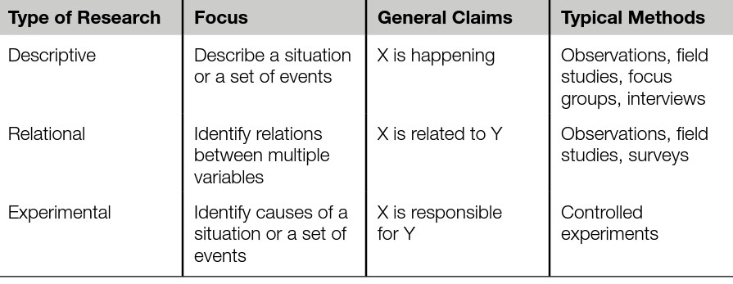
Type of Research
Table 2.1 Relationship Between Descriptive Research, Relational Research, and Experimental Research
Lazar, J., Feng, J.H. and Hochheiser, H. (2017) Research methods in human-computer interaction. Second edition. Cambridge, Massachusetts: Morgan Kaufmann Publishers, pp. 27

Slide 11
Research Question
A research question is a question that a study or research project aims to answer.
It addresses an issue or a problem, which, through analysis and interpretation of data, is answered in the study’s conclusion.
A research question is written so that it outlines various aspects of the study, including:
the population/units ((the objects to which we apply the experiment treatments, in UX context the units are normally human subjects with specific characteristics, such as gender, age, or computing experience)
the variables to be studied
the problem the study addresses, and
it identifies the research design
  the treatments, or conditions that refer to the different techniques, devices, or procedures that we want to compare
  the assignment method, the way in which the experimental units are assigned different treatments

Slide 12
Types of Research questions
Aspect | Quantitative Research Questions | Qualitative Research Questions | Mixed Research Questions
Nature of Inquiry | Focuses on measurable, objective data | Explores subjective experiences or meanings | Combines measurable data with in-depth understanding
Question Structure | Specific, closed-ended, focused on relationships or effects | Open-ended, broad, and exploratory | Includes both specific, measurable aspects and exploratory elements
Data Type | Numerical (quantifiable) | Non-numerical (descriptive, textual) | Both numerical and non-numerical (quantitative and qualitative)
Analysis Method | Statistical analysis (e.g., correlations, comparisons) | Thematic or narrative analysis | Both statistical analysis and thematic/narrative analysis
Objective | To measure, predict, or establish patterns | To understand, describe, and interpret | To integrate measurement with context to provide a comprehensive view
Typical Phrasing | "What is the effect of…?" "What is the relationship between…?" | "How do people experience…?" "What are the perceptions of…?" | "How does X relate to Y, and how do participants perceive Z?"
Strengths | High generalizability, objective insights | Deep, context-rich understanding | Provides a well-rounded view, combining depth with breadth
Limitations | May lack context and depth | May lack generalizability and is often subjective | Can be complex to design and analyze, requiring careful integration of methods

Slide 13
Steps to design a good research question
Start with a broad topic
Do preliminary research to learn about topical issues.
Narrow down your topic to a specific niche
Identify the research problem
Turn the research problem to a research question
Does it state
Social media
Social media has negative impact on high school students’ academic performance. This age group is the most active on social media
Academic performance is too broad we can narrow it down to attention span
We have identified that the most active group on social media is teenagers. However, only a small amount of research has been on the effect social media on young generation’s attention span.
What effect does daily use of Snapchat has on the attention span of people in the age group of 16 to 20?
  the population to be studied
  dependent and independent variables, and
  the research design to be used
Notes:
Focused – attention span
Researchable – can it be evaluated by collecting experimental data or literature review?
Feasible – within the timeframe?
Specific – specific age group
Complex – it cannot be answered with yes or no
Relevant – social media is something used widely in our society with makes it very relevant

Slide 14
Steps to design a good research question
Start with a broad topic
Do preliminary research to learn about topical issues.
Narrow down your topic to a specific niche
Identify the research problem
Turn the research problem to a research question
Evaluate the soundness of your research question.
Social media
Social media has negative impact on high school students’ academic performance. This age group is the most active on social media
Academic performance is too broad we can narrow it down to attention span
We have identified that the most active group on social media is teenagers. However, only a small amount of research has been on the effect social media on young generation’s attention span.
What effect does daily use of Snapchat has on the attention span of people in the age group of 16 to 20?
Is it Feasible, Interesting, Novel, Ethical, Relevant
Notes:
Focused – attention span
Researchable – can it be evaluated by collecting experimental data or literature review?
Feasible – within the timeframe?
Specific – specific age group
Complex – it cannot be answered with yes or no
Relevant – social media is something used widely in our society with makes it very relevant

Slide 15
Forming the good research question
Hulley et al. (2007) Designing Clinical Research, 3rd Edition, Suggest using a set of criteria- known as the “FINER” criteria-to find out if you have a good research question. The FINER criteria are outlined below:
F – Feasible
A good research question is feasible, which means that the question is well within the researcher’s ability to investigate. Researchers should be realistic about the scale of their research as well as their ability to collect data and complete the research with their skills and the resources available to them. It’s also wise to have a contingency plan in place in case problems arise.
I – Interesting
The ideal research question is interesting not only to the researcher but also to their peers and community. This interest boosts the researcher’s motivation to see the question answered.
N – Novel
Your research question should be developed to bring new insights to the field of study you are investigating. The question may confirm or extend previous findings on the topic you are researching, for instance.
E – Ethical
This is one of the more important considerations of making a research question. Your research question and your subsequent study must be something that review boards and the appropriate authorities will approve.
R – Relevant
Aside from being interesting and novel, the research question should be relevant to the scientific community and people involved in your area of study.

Slide 16
Question 1
What type of research question is this?
  Quantitative, Qualitative
What type of behavioural research?
  Descriptive, Relational, Mixed
Why?
What are the self-reported levels of attention span among individuals aged 16 to 20 who use Snapchat daily at different frequencies?
Quantitative: The question suggests collecting measurable data on attention span levels and Snapchat usage frequencies. This data can be numerically analysed to describe different levels of attention span across usage groups.
Descriptive: The question is focused on describing the self-reported attention span levels for different groups based on Snapchat usage frequency. It does not imply a cause-effect relationship or seek to explore a correlation, making it descriptive.

Slide 17
Question 2
Turn the following question to relational research question and causal research question
“What are the self-reported levels of attention span among individuals aged 16 to 20 who use Snapchat daily at different frequencies?”
Relational Research Question:
  How does the frequency of Snapchat usage correlate with changes in the attention span of individuals aged 16 to 20?
  "Is there an impact of daily Snapchat use to the attention span of individuals aged 16 to 20?“
  This is a relational research question because it focuses on the relation of the frequency of Snapchat usage to attention span
Causal Research Question:
  "To what extent does daily use of Snapchat cause changes in the attention span of individuals aged 16 to 20?“
  "How does daily use of Snapchat cause changes in the attention span of individuals aged 16 to 20?"
  This question focuses more explicitly on understanding the causal relationship between Snapchat use and changes in attention span.
How would you study those?
Notes:
How would you study it?
Set up a study with different groups exposed in different number of hours in SnapChat in daily basis for a period of time and access their attention span at the end , then compare the results etween the different groups and identify relation between number of hours of exposure too SnapChat in daily basis to attention span.

Slide 18
Some examples of Bad & Good Research questions
Bad: Has there been an increase in purchases in a website in the past 5 months?
Why?
    1. Lack of Specificity: The question is vague about what kind of "purchases" are being measured (e.g., total sales, number of unique transactions, specific product categories).
    2. Missing Comparison Basis: It asks whether there has been an increase in the past five months, but it doesn’t specify what this period should be compared to (e.g., the previous five months, the same period last year).
    3. Potential for Simple Data Analysis: This question could be answered with a simple descriptive data comparison rather than a research study, which may not yield insightful results unless further context is provided.
Good: How the deployment of the new website affected purchase level in male and female population in specific categories of items in the past 5 months?
Bad: Users want to be able to filter products by colour
Better: Adding a colour filter would make it easier for users to find the right products
Good: How does the ability to filter products by colour impact user satisfaction and support users to find the product they are looking for?
Notes:
Bad: Has there been an increase in purchases in a website in the past 5 months?
Good: How the deployment of the new website affected purchase level in male and female population in specific categories of items in the past 5 months?
In the second example, the first research question is not ideal because it’s too simple, and it’s easily answerable by a “yes” or “no.” The second research question is more complicated; to answer it, the researcher must collect data, perform in-depth data analysis, and form an argument that leads to further discussion.
Bad: Users want to be able to filter products by colour
There are various approaches to test the hypothesis but they do not and cannot prove or disprove our hypothesis. It’s not that the research methods are ineffective it’s that the hypothesis itself is poorly expressed.
The first problem is that there are hidden assumptions made by this hypothesis. Presumably we would be doing this research to decide between a choice of possible filters we could implement. But there’s no obvious link between users wanting to filter by colour and a benefit from us implementing a colour filter. Users may say they want it but how will that actually benefit their experience?
The second problem with this hypothesis is that we’re asking a question about “users” in general. How many users would have to want colour filters before we could say that this hypothesis is true?
Better: Adding a colour filter would make it easier for users to find the right products
This is an obvious improvement to the first example but it still has problems. We could of course identify further assumptions but that will be true of pretty much any hypothesis. The problem again comes from speaking about users in general.
Perhaps if we add the ability to filter by colour it might make the possible filters crowded and make it more difficult for users who don’t need colour to find the filter that they do need. Perhaps there is a sample bias in our research participants that does not apply broadly to our user base.
It is difficult (though not impossible) to design research that could prove or disprove this hypothesis. Any such research would have to be quantitative in nature. And we would have to spend time mapping out what it means for something to be “easier” or what “the right products” are.
Good: Adding a colour filter would have an effect on users finding the right products

Slide 19
Frameworks used to develop the research question in traditional research
Health | Social Sciences | Interdisciplinary
PICO(T) | SPICE | WWH
PHICOC | PIECE | PROPHET
Frameworks for research questions

Slide 20
LEAN UX
Lean UX is focused on the experience under design where user feedback is incorporated quickly to validate ideas.
The core objective is to focus on obtaining feedback as early as possible so that it can be used to make quick decisions.
The nature of Agile development is to work in rapid, iterative cycles and Lean UX mimics these cycles to ensure that data generated can be used in each iteration.

Slide 21
LEAN UX
If we [do, build, provide x thing],
Then [these people]
Will [some desirable outcome].
We’ll know when [actionable metrics].
The [do, build, provide] = what solution you’re proposing
These people = Actual target audience
The [some desirable outcome] = what you want people to do
The [measure of success] = your goals to fill comfortable whether or not you should move forward

Slide 22
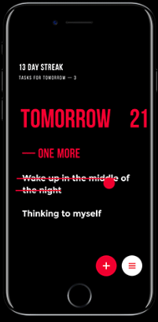
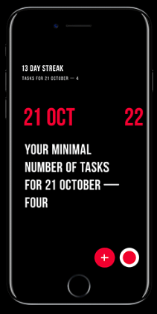
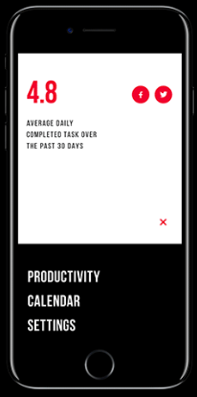
Example
Upper App is a simple and elegant to-do list application increasing users’ productivity.
In UX perspective, the to-do list design is focused on extremely simple interactions and intuitive navigation
In UI aspect, the core concerns are high readability level and ease of access that would allow users to use the app easily in any environment and on the go.
High readability – with the colour scheme used
Basic functional buttons are placed in the bottom of the screen, which supports usability for users with big devices. Different swipe gestures allow a user to mark the task complete or delete it from the list.

Slide 23
Descriptive Research Question
“How do users with large devices engage with the basic task management buttons of the Upper App when placed at the bottom of the screen?”
  The variables are not defined as descriptive research typically does not involve manipulating an independent variable to observe changes in a dependent variable. However, if we identify components of interest:
  Independent Variable (Context): The placement of the task management buttons at the bottom of the screen. This is a contextual factor rather than a manipulated variable.
  Dependent Variable (Observed Behaviour): How users with large devices engage with the buttons. This could include specific engagement metrics like frequency, ease of access, time spent on tasks, or other qualitative observations.
  In this case, the placement is a condition or context for observation, and the users' engagement behaviours are the outcomes being described.
Basic functional buttons are placed in the bottom of the screen, which supports usability for users with big devices. Different swipe gestures allow a user to mark the task complete or delete it from the list.

Slide 24

Research Question
“What is the effect of placing the basic task management buttons of Upper App at the bottom of the screen for users with big devices in the speed of completing basic functional tasks?”
  Does it state:
  the population to be studied
  dependent and independent variables, and
  the research design to be used
Basic functional buttons are placed in the bottom of the screen, which supports usability for users with big devices. Different swipe gestures allow a user to mark the task complete or delete it from the list.
We’ll know if this is true when 80% of people asked to add a new task in their list will be able to do it using only one hand in less time compared to other products with the basic functional buttons at the top of the screen. We need a benchmark.

Slide 25



Relational Research Question
“How does the placement of basic task management buttons at the bottom of the screen for
  female and male users
  users in different age groups [20-40, 40-50, 50+]
  users with small and larger devices
relate to the speed of completing basic functional tasks in the Upper App?”
  Does it state:
  the population to be studied
  dependent and independent variables, and
  the research design to be used
Basic functional buttons are placed in the bottom of the screen, which supports usability for users with big devices. Different swipe gestures allow a user to mark the task complete or delete it from the list.
  Observe different groups of users completing a number of basic functional tasks using Upper App and noting the time completion.

Slide 26


Experimental Research Question (causal)
“Does the placement of basic task management buttons of the screen for users with larger devices to the speed of completing basic functional tasks in the Upper App?”
  Does it state:
  the population to be studied
  dependent and independent variables, and
  the research design to be used
Basic functional buttons are placed in the bottom of the screen, which supports usability for users with big devices. Different swipe gestures allow a user to mark the task complete or delete it from the list.
  Design an experiment with different research instruments [app with the placement of buttons at the bottom vs at the top of the screen], ask users to complete a number of basic functional tasks and noting the time completion.

Slide 27


Directional Experimental Research Question
“Does the placement of basic task management buttons of the screen for users with larger devices increases the speed of completing basic functional tasks in the Upper App?”
  Does it state:
  the population to be studied
  dependent and independent variables, and
  the research design to be used
Basic functional buttons are placed in the bottom of the screen, which supports usability for users with big devices. Different swipe gestures allow a user to mark the task complete or delete it from the list.
  Design an experiment with different research instruments [app with the placement of buttons at the bottom of the screen vs buttons at the top of the screen], ask users to complete a number of basic functional tasks and noting the time completion.

Slide 28
Research hypothesis
A research hypothesis is a statement of expectation or prediction that will be tested by research.

Slide 29
Forming a hypothesis
Once the research goal question/s is/are firmly established the next logical step is to develop a set of hypotheses based on the question/s posed by your study.
A hypothesis is a declarative statement about the relationship between two or more variables based on statistical consideration.
A hypothesis is a specific, testable prediction about what you expect to happen in your study.
For example, a study designed to look at the relationship between time in the day and e-shopping might have a hypothesis that states:
  “The number of website purchases made after the broadcast of X TV series is higher than the number of purchases made in the morning (8 a.m. to 10 a.m.)”.
  This research hypothesis makes a specific prediction about the relationship between the timing of TV series viewing and website purchases, allowing for empirical testing and analysis to determine if the hypothesis is supported by the data.
Notes:
This research hypothesis makes a specific prediction about the relationship between the timing of TV series viewing and website purchases, allowing for empirical testing and analysis to determine if the hypothesis is supported by the data.

Slide 30
Null hypothesis (H₀₎
The null hypothesis (H₀) represents the default or no-effect statement, indicating no change, no difference, or no association between variables.
It is usually the hypothesis that researchers aim to test against to see if there is enough evidence to reject it.
Example: 𝐻₀​ : "There is no increase in website purchases after the broadcast of X TV series compared to the purchases made in the morning."
Notes:
H sub zero or H naught

Slide 31
Alternative hypothesis (H₁ or H_{a})
The alternative hypothesis (H₁ or H_{a}) represents the statement that there is an effect, difference, or association.It is what researchers are trying to find evidence for.
Example: 𝐻₁ : "There is an increase in website purchases after the broadcast of X TV series compared to the purchases made in the morning."
Notes:
H sub zero or H naught

Slide 32
Mathematical expression of H0 and H1
  where:
  H₀ = the null hypothesis
  μ₁ = the mean of population 1
  μ₂ = the mean of population 2
  H₀: μ₁ = μ₂ or H₀: μ₁ - μ₂ = 0
  H_{a} μ₁ ≠ μ₂
  Usually we are trying to evaluate if the outcomes of a study would lead to a rejection of the null hypothesis
Notes:
H sub zero or H naught

Slide 33
Hypotheses Tips
The question comes first. Before you make a hypothesis, you have to clearly identify the question you are interested in studying
A hypothesis is a statement, not a question. Your hypothesis is not the scientific question in your project. The hypothesis is an educated, testable prediction about what will happen.
Make it clear. A good hypothesis is written in clear and simple language. Reading your hypothesis should tell a teacher or judge exactly what you thought was going to happen when you started your project.
Keep the variables in mind. A good hypothesis defines the variables in easy-to-measure terms, like who the participants are, what changes during the testing, and what the effect of the changes will be.
Make sure your hypothesis is "testable." To prove or disprove your hypothesis, you need to be able to do an experiment and take measurements or make observations to see how two things (your variables) are related. You should also be able to repeat your experiment over and over again, if necessary. To create a "testable" hypothesis make sure you have done all of these things:
  Thought about what experiments you will need to carry out to do the test.
  Identified the variables in the project.
  Included the independent and dependent variables in the hypothesis statement. (This helps ensure that your statement is specific enough.
You might find it helpful to consult a statistician once your research questions and corresponding hypotheses are finalized to discuss experimental design, data collection, and statistical analyses.

Slide 34
Turn the Research Question to hypothesis
“What is the effect of placing the basic task management buttons of Upper App at the bottom of the screen for users with big devices in the speed of completing basic functional tasks?”
Null Hypothesis (H₀): Placing the basic task management buttons of Upper App at the bottom of the screen does not have a significant effect on the speed of completing basic functional tasks for users with big devices.
Alternative Hypothesis (H₁): Placing the basic task management buttons of Upper App at the bottom of the screen results in a significant improvement in the speed of completing basic functional tasks for users with big devices.
Which are the dependent and the independent variables?
How would you evaluate the hypothesis?
Test two designs with buttons at the top and at the bottom of the screen, either two different prototypes, or two different tasks of equal level of difficulty (requiring the same time to be completed) where the buttons are placed at the top or at the bottom
H₀: μ₁ = μ₂
  μ₁ = time in entering a new task when using Upper App
  μ₂ = time in entering a new task using a competitor's product
or
  μ₁ = time in entering a new task when using Prototype A with functional buttons at the bottom of the screen
  μ₂ = time in entering a new task when using Prototype B with functional buttons on top of the screen
Basic functional buttons are placed in the bottom of the screen, which supports usability for users with big devices. Different swipe gestures allow a user to mark the task complete or delete it from the list.

Slide 35
Include benchmark
“What is the effect of placing the basic task management buttons of Upper App at the bottom of the screen for users with big devices in the speed of completing basic functional tasks?”
What if we wanted to include the benchmark in the statement?
Null Hypothesis (H₀): Placing the basic task management buttons of Upper App at the bottom of the screen does not have a significant effect on the speed of completing basic functional tasks for 80% of users with big devices.
Alternative Hypothesis (H₁): Placing the basic task management buttons of Upper App at the bottom of the screen results in a significant improvement in the speed of completing basic functional tasks for 80% of users with big devices.
Basic functional buttons are placed in the bottom of the screen, which supports usability for users with big devices. Different swipe gestures allow a user to mark the task complete or delete it from the list.

Slide 36
Study relation
“What is the effect of placing the basic task management buttons of Upper App at the bottom of the screen for users with big devices in the speed of completing basic functional tasks?”
What if we wanted to study relation of male vs female and speed
Null Hypothesis (H₀): Placing the basic task management buttons of Upper App at the bottom of the screen results in the same speed of completing basic functional tasks for both male and female users with big devices.
Alternative Hypothesis (H₁): Placing the basic task management buttons of Upper App at the bottom of the screen results in a different speed of completing basic functional tasks for male and female users with big devices.
  H₀: μ₁ = μ₂
  μ₁ = time male
  μ₂ = time female
In this context, the null hypothesis assumes that there is no significant difference in task completion speed between male and female users, while the alternative hypothesis suggests that there is a significant difference.
Basic functional buttons are placed in the bottom of the screen, which supports usability for users with big devices. Different swipe gestures allow a user to mark the task complete or delete it from the list.

Slide 37
Causal research
“Changing the placement of basic task management buttons to the bottom of the screen for users with larger devices increases the speed of completing basic functional tasks in the Upper App?”
Null Hypothesis (H₀): Changing the placement of basic task management buttons to the bottom of the screen does not increase the speed of completing basic functional tasks for users with larger devices in the Upper App.
Alternative Hypothesis (H₁): Changing the placement of basic task management buttons to the bottom of the screen increases the speed of completing basic functional tasks for users with larger devices in the Upper App.
  H₀: μ₁ = μ_{2 ,} H_{a}: μ₁ > μ₂
  μ₁ = time tasks bottom button placement
  μ₂ = time tasks top button placement
These hypotheses allow you to test whether the placement of the buttons has a significant impact on the speed of task completion in the Upper App.
Basic functional buttons are placed in the bottom of the screen, which supports usability for users with big devices. Different swipe gestures allow a user to mark the task complete or delete it from the list.

Slide 38
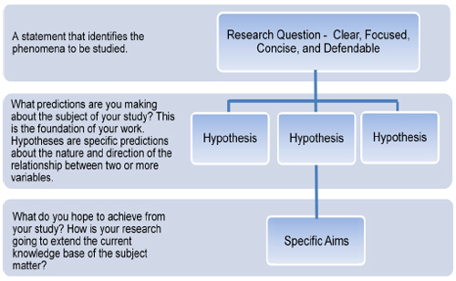
Recap on Research Process Hierarchy
Tips for Formulating a Research Question and Study Design (Image: U.S. Army Institute of Surgical Research

Slide 39
Typical variables in UX research
Independent
Dependent
Control
Extraneous Variables

Slide 40
Independent variables in UX context
These are the variables that the researcher manipulates to observe their impact on usability

Slide 41
UX Independent variables – design
Typical independent variables that relate to technology include:
  Interface Design Variants: Different versions of an interface, such as layouts, button placements, or navigation structures.

Slide 42
UX Independent variables – technology related
Typical independent variables that relate to technology include:
  different types of technology or devices, such as typing versus speech-based dictation, mouse versus joystick, touch pad, and other pointing devices;
  different types of design, such as pull-down menu versus pop-up menu, font sizes, contrast, background colors, and website architecture.

Slide 43
UX Independent variables – users
Typical independent variables that relate to users include:
  Age
  Gender
  Computer experience
  Professional domain
  Education
  Culture
  Motivation
  Mood, and
  Disabilities

Slide 44
UX Independent variables – user tasks
Different tasks users are asked to complete, which can vary in complexity or sequence.

Slide 45
UX Independent variables – context of use
Typical independent variables that relate to the context of use of technologies include:
  physical factors
    environmental noise
    Lighting
    Temperature
    vibration, users' status (e.g., seated, walking or jogging) ( Price et al., 2006 )
  social factors
    such as the number of people surrounding the user and their relation to the user.

Slide 46
Dependent variables in UX context
In the UX, dependent variables are usually related to:
  Effectiveness - whether users successfully complete a task (task success rate).
  Efficiency - time to complete a task and speed (e.g., words per minute, number of targets selected per minute)
  Accuracy - describes the states in which the system or the user makes errors
  Subjective satisfaction - describes the user's perceived satisfaction with the interaction experience, often measured through post-task or post-test surveys, such as the System Usability Scale (SUS) or Net Promoter Score (NPS).
  Ease of learning and retention rate - how quickly and how easily an individual can learn to use a new application or complete a new task and how long they retain the learned skills
  Physical or cognitive demand (load) that an application or a task exerts on an individual or how long an individual can interact with an application without significant fatigue. Sometimes measured via subjective scales (like NASA-TLX) to assess how mentally challenging users find a task, or biometrics.

Slide 47
Control variables in UX context
These are factors kept constant to ensure they don’t influence the results.
  Environment: Keeping testing conditions the same, such as lighting, noise, or time of day.
  Task Instructions: Ensuring all users receive the same instructions for consistency.
  Device Settings: Keeping screen brightness, font size, or display settings consistent across devices if they are not being tested.

Slide 48
Extraneous variables in UX context
These are unplanned factors that could influence results and are typically minimized or controlled for accuracy.
  User Fatigue: The user's energy level, which may decline with longer testing sessions.
  User Mood or Stress Levels: Emotional states that could influence performance, particularly in more complex tasks.
  Previous Experience with Similar Interfaces: Users with prior experience in similar apps or interfaces may perform differently than those without it.

Slide 49
Experimental research
Experimental research can allow causal inference while descriptive and relational investigations do not.

Slide 50
Experimental design
In experimental design, the investigator can fully control or manipulate the experimental conditions so that a direct comparison can be made between two or more conditions while other factors are, ideally, kept the same.
Notes:
In experimental design, the investigator can fully control or manipulate the experimental conditions so that a direct comparison can be made between two or more conditions while other factors are, ideally, kept the same.
One aspect of the control of factors is complete randomization, which means that the investigator can randomly assign participants to different conditions.
Another aspect the capability to effectively control for variables not of interest, therefore limiting the effects to the variables being studied, is the feature that most differentiates experimental research from quasi-experimental research, descriptive investigations, and relational investigations.

Slide 51
Components of an experiment
After a research hypothesis is identified, the design of an experiment consists of three components:
  Treatments, or conditions, refer to specific variations or setups that the researcher manipulates to observe their impact on usability outcomes (independent variables)
  People/Units are the objects to which we apply the experiment treatments, in UX context the units are normally human subjects with specific characteristics, such as gender, age, or computing experience
  Assignment method refers to the way in which the experimental units are assigned different treatments.

Slide 52
Experiment characteristics
The dependent variables are normally measured through quantitative measurements.
The results are analyzed through various statistical significance tests.
A true experiment should be replicable with different participant samples, at different times, in different locations, and by different experimenters.

Slide 53
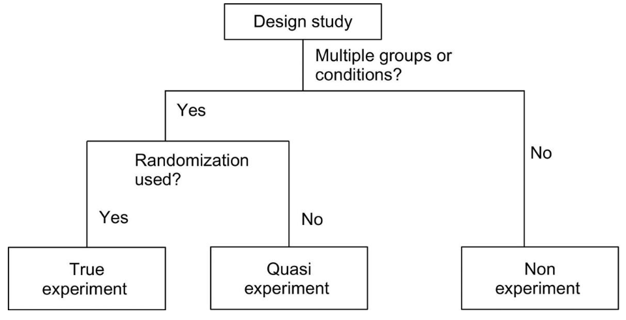
Groups of studies
Experiment is a controlled and systematic procedure carried out to investigate and test a specific hypothesis or research question to establish causal relationships between variables. In an experiment, researchers manipulate one or more independent variables to observe their effects on one or more dependent variables while controlling and accounting for extraneous factors.
Non-experiments, also known as a non-experimental study or observational study, is a type of research design in which researchers do not manipulate any variables or impose specific interventions. Instead, they observe and collect data on naturally occurring phenomena as they exist in their real-world settings. Non-experimental studies are used to understand relationships, associations, and patterns without introducing any artificial changes.
Quasi-experiments are a type of research design that shares some characteristics with both experimental and non-experimental research. In a quasi-experiment, researchers study the impact of an independent variable on a dependent variable, much like in traditional experiments. However, quasi-experiments lack some of the strict control and random assignment found in true experiments.
Cooper D, Schindler P. Business Research Methods. seventh ed. Boston, MA: McGraw Hill; 2000.
Rosenthal R, Rosnow R. Essentials of Behavioral Research: Methods and Data Analysis. third ed. Boston, MA: McGraw Hill; 2008.

Slide 54
Experiment components & characteristics
Example
Hypothesis - There is no difference between the target selection speed when using a mouse, a joystick, or a trackball to select icons of different sizes (small, medium, and large)
2 independent variables in this hypothesis:
  the type of pointing device and
  the size of icon
Three different pointing devices will be examined:
  a mouse,
  a joystick, and
  a trackball
suggesting three conditions
Three different target sizes will be examined:
  small,
  medium, and
  large
suggesting three conditions
Since we need to test each combination of values of the two independent variables, combining the two independent variables results in a total of nine (3 × 3 = 9) conditions in the experiment.
A true experiment is based on at least one testable research hypothesis and aims to validate it.
There are usually at least two conditions (a treatment condition and a control condition) or groups (a treatment group and a control group).
The dependent variables are normally measured through quantitative measurements.
The results are analyzed through various statistical significance tests.
A true experiment should be designed and conducted with the goal of removing potential biases.
A true experiment should be replicable with different participant samples, at different times, in different locations, and by different experimenters.

Slide 55
Experiment characteristics
Example
Hypothesis - There is no difference between the target selection speed when using a mouse, a joystick, or a trackball to select icons of different sizes (small, medium, and large)
Since we need to test each combination of values of the two independent variables, combining the two independent variables results in a total of nine (3 × 3 = 9) conditions in the experiment.
How are we going to assign users to those 9 conditions?
  Randomly? [true experiment]
  or
  Based on what type of devices do they use more frequently? Mouse, joystick, or trackball? – categorise the users based on prior experience [quasi-experiment]
researchers measure variables as they naturally occur without any further manipulation

Slide 56
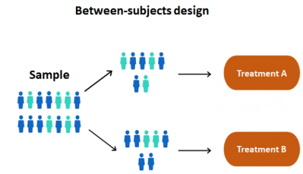
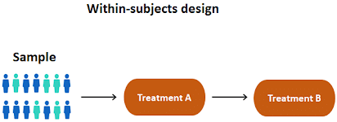
Type of Experiment Design
9 treatments x 3 conditions = 9 groups
Treatment small icons | Treatment medium icons | Treatment large icons
small icons - mouse | medium icons - mouse | large icons - mouse
small icons - joystick | medium icons - joystick | large icons - joystick
small icons - trackball | medium icons - trackball | large icons - trackball
3 treatments = 3 groups
Treatment small icons | Treatment medium icons | Treatment large icons
mouse | mouse | mouse
joystick | joystick | joystick
trackball | trackball | trackball

Slide 57
Type of Experiment Design
 | Between-Group Design | Within-Group Design
Advantages | Cleaner Avoids learning effect Better control of confounding factors, such as fatigue | Smaller sample size Effective isolation of individual differences More powerful tests
Limitations | Larger sample size Large impact of individual differences Harder to get statistically significant results | Hard to control learning effect Large impact of fatigue

Slide 58
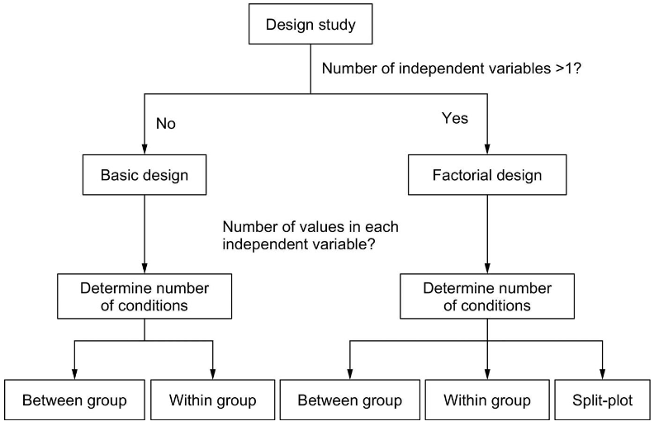
What determines the experiment structure

Slide 59


Between Group vs Within Group
H1: There is no difference in typing speed when using a QWERTY keyboard, a DVORAK keyboard, 1 or an alphabetically ordered keyboard.
H2: There is no difference in the time required to locate an item in an online store between novice users and experienced users.
H3: There is no difference in the perceived trust toward an online agent among customers who are from the United States, Russia, China, and Nigeria.
Dependent variable – typing speed
Independent variable – keyboard
Conditions – QWERTY keyboard, DVORAK keyboard, alphabetically ordered keyboard.

Slide 60
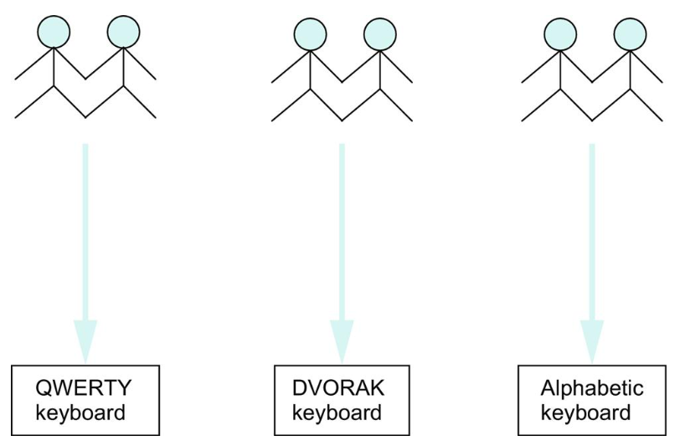
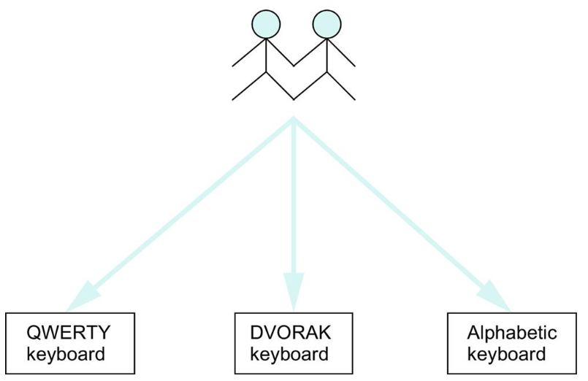
Between Group vs Within Group
Between-group design
(between-subject design)
Within-group design
(within-subject design)
each participant is only exposed to one experimental condition
each participant to be exposed to multiple experimental conditions

Slide 61

Between Group vs Within Group
H1: There is no difference in typing speed when using a QWERTY keyboard, a DVORAK keyboard, 1 or an alphabetically ordered keyboard.
H2: There is no difference in the time required to locate an item in an online store between novice users and experienced users.
H3: There is no difference in the perceived trust toward an online agent among customers who are from the United States, Russia, China, and Nigeria.
Dependent variable – time [H2], trust [H3]
Independent variable – novice vs experienced users [H2], customers from different geographical locations [H3]
Conditions – novice vs experienced users [H2], customers from different geographical locations [H3]

Slide 62
Split-Plot Design
H4 There is no difference in [speed/satisfaction] among different driver age groups (20-40, 41-60, 60+) when driving with or without GPS assistance
 | 20–40 Years Old | 41–60 Years Old | Above 60
Driving without GPS assistance | 1 | 2 | 3
Driving with GPS assistance | 4 | 5 | 6
Between-group
Within-group

Slide 63
Factorial design
Factorial designs are widely adopted when an experiment investigates more than one independent variables or factors.
We divide the experiment groups or conditions into multiple subsets according to the independent variables.
It allows us to simultaneously investigate the impact of all independent variables as well as the interaction effects between multiple variables.
H₀: There is no difference in [speed/satisfaction] among different driver age groups (20-40, 41-60, 60+) when driving with or without GPS assistance

Slide 64
Factorial design
Within-group design is more appropriate when the experiment investigates tasks with large individual differences, tasks that are less susceptible to the learning effect, or when the target participant pool is very small

Slide 65
Reliability of Experimental design
Well-designed experiments can reveal important scientific findings.
By contrast, ill-designed experiments may generate results that are false or misleading.
Notes:
In experimental design, the investigator can fully control or manipulate the experimental conditions so that a direct comparison can be made between two or more conditions while other factors are, ideally, kept the same.
One aspect of the control of factors is complete randomization, which means that the investigator can randomly assign participants to different conditions.
Another aspect the capability to effectively control for variables not of interest, therefore limiting the effects to the variables being studied, is the feature that most differentiates experimental research from quasi-experimental research, descriptive investigations, and relational investigations.

Slide 66
Reliability of Experimental Results
Random error - “chance errors” or “noise”, occurs by chance and are not correlated with the actual value.
  Random errors push the observed values to move up or down around the exact value.
  There is no way to eliminate or control random error, but we can reduce the impact of random errors by enlarging the observed sample size.

Slide 67
Reliability of Experimental Results
Systematic error – bias, systematic errors always push the observed values in the same direction (e.g. the participant might consistently underperform during all five observation sessions, because of tiredness or nervousness, or over-perform because of training)
Bias Caused by:
  Measurement Instruments
  Experimental Procedures
  Participants
  Experimenter Behaviour
  Environmental Factors

Slide 68
Recap
  Types of behavioural research
  Forming a Research question and developing research hypotheses
  Variables in the context of usability testing
  Experimental research & experimental design
Next week – preparation of test plan and research instruments to support experimental research, ethics

Slide 69
Test your understanding
Behavioural Research
  What are the 3 types of behavioural research?
  What is the difference between Descriptive Research, Relational research and experimental (causal) research. Can you think of some examples?
  Why is it important to start your study by having a clear research goal?
Research questions
  What are the main aspects that a research question outlines?
  Follow the steps of creating a good research question and create an example of a Descriptive, Relational, and experimental research question
  Evaluate the research questions you have created based on the following criteria: Is it Focused, Researchable, Feasible, Specific, Complex, Relevant
Research hypothesis
  What do you need to do to form a clear hypothesis?
  Turn the research questions you have created to research hypotheses, identify what are the variables you will be studying. How many variables you study? Do those variables help you to evaluate usability criteria of the product you are testing?
  What method would you use to study those hypotheses (basic design, factorial / within group, between group, split-plot)?
Common usability testing variable
  What are the typical variables in usability testing experimental context
Experimental design
  Explain the differences among the three types of study: experiment, quasi-experiment, and nonexperiment.
  What are the major issues that need to be considered when designing experiments?
  What is a between-group design? Explain the advantages and disadvantages of a between-group design.
  What is a within-group design? Explain the advantages and disadvantages of a within-group design.
  When should a between-group design be considered for an experiment?
  When should a within-group design be considered for an experiment?
  What is the benefit of a factorial design compared to experiments that investigate one factor at a time?
  What is a split-plot design?

Slide 70
Reading
Lazar, J., Feng, J.H. and Hochheiser, H. (2017) Research methods in human-computer interaction. Second edition. Cambridge, Massachusetts: Morgan Kaufmann Publishers.
  Chapter 2, Experimental Research
  Chapter 3, Experimental Design
Albert, B. & Tullis, T. (2013) Measuring the User Experience, 2nd Edition, Publisher(s): Morgan Kaufmann
  Chapter 3, Planning
Online Resources
  How to Write a Research Question: Types, Steps, and Examples
    https://research.com/research/how-to-write-a-research-question

